Slide 1
Hate Speech Detection based on Sentiment Knowledge Sharing
Team: 01
ID: 20101208
Md. Fardin Ahsan
Section: 01
ST: Mustakin
RA: Mehedi
1

Slide 2
Introduction
A growing concern in today's digital world
Existing methods of detecting hate speech mainly rely on machine learning algorithms
With the growth of online communication, hate speech has become more prevalent
2

Slide 3
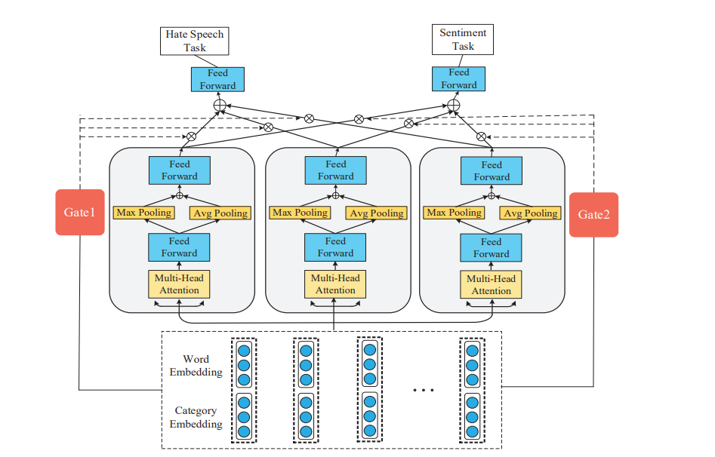
Related Work
Input layer
Sentiment knowledge sharing layer
Gated attention layer
Sentiment Knowledge Sharing(SKS).
3

Slide 4
Process
1. Remove stop words, punctuation and other sound words
2. Sentiment scores are assigned.
4

Slide 5
Advantage & Disadvantage
Conclusion of Hate Speech Detection based on Sentiment Knowledge Sharing
Using shared sentiment knowledge to detect hate speech has several advantages as well as some disadvantages.
5

Slide 6
Future Plans
1. Developing better sentiment lexicons
2. Exploring the use of context in hate speech detection
3. Developing methods for evaluating the performance of hate speech detection models
4. Studying the ethical implications of hate speech detection
5. Developing methods to detect hate speech in multimedia content
6

Slide 7
Conclusion
This method detects hate speech
To ensure accurate and comprehensive detection of hate speech
Using sentiment analysis to improve hate speech detection accuracy
7

